Slide 1


Bank of Baroda Hackathon - 2022
Technology Partner
Your Team Name : SS_ROBOTTO
Your team bio : SSG_RPADevelopers
Date : 18 September 2022

Slide 2
Problem Statement?
Bank handles large volumes of cheques in the clearing process. The process involves many technical verifications including signature verification.
Some of these steps are manual and require human intervention to complete the process. The current process requires the high human capital deployment and longer processing time.
Why did you decide to solve this Problem statement?
Bank cheques are still widely used for financial transactions. Huge volumes of handwritten bank cheques are processed manually every day. In such a manual verification, user written information including date, signature, legal and courtesy amounts present on each cheque to be visually verified.
Much time, effort and money can be saved if this entire process of recognition, verification and data entry is done automatically using images of cheques.
As a result, high number of FTE savings can be achieved and in turn highest return on investment can be attained in few months.

Slide 3
User Segment & Pain Points
BOB has various branches located out of different cities within the country and every branch manage the cheque processing from their respective branches.
As this is manual task it takes high human capital deployment and longer processing time.
An automated solution is needed with high accuracy to deal with this obstacle and which is prone to less errors and also reduce human efforts and processing time.
This solution will help to manage the cheque processing centrally. A small team can now be able to process the cheques easily from the User portal which will be created as a part of this solution and can verify/update the details in seconds.
In the AS-IS process, bank officer has to login to the bank account for the customer to view the signature and verify the details. However, in the To-Be process all the required details will be available on a single screen. This will also mitigate the risk of accessing unnecessary details from the customer account.

Slide 4
Pre-Requisite
What are the alternatives/competitive products for the problem you are solving?
Some countries are using products for their cheque verification system which are based on rule based, graph based, CNN techniques etc.
For instance - ‘A2iA’, ‘Mitek’, ‘Parascript’ and ‘SoftPro’

Slide 5
Azure tools or resources
Power Automate/AI Builder Power automate will be triggered for every entry created in the database (cheque images and MICR data). AI Builder to extract the data from cheque image and update the database.
Azure cognitive services Azure cognitive services will be used to invoke multilingual capabilities (to support multi language cheques) and web services (to integrated with banking application)
Python Solution will be integrated with Python (OpenCV library/Scikit-image) for signature verification and determine the confidence level which will be reflected in the User portal
Power APP A Power app User portal will be created and integrated with the solution. All the items which are not verified will be reflected in the user portal along with customer signature and cheque image

Slide 6
Any Supporting Functional Documents
Creating a solution by integrating various tools/technologies which can cater to the end-to-end automation requirement for one of the banking activity named cheque processing.
The concept is to build a platform by using Power automate which firstly extracts the details from the cheque (which are scanned and stored in a Share point) with the support of AI builder. The extracted details are then stored in a database.
A user portal will be created on Power app and integrated with the database and banking application in such a manner that through which a banking officer can view the scanned cheque image(only if the accuracy level is below 50%), signature for the specific client (available within banking software) and details extracted from cheque, all on a single screen. This will enable the officer to verify the details quickly and modify any details if found incorrect and then click on ‘Verify’ button. All the modified details will get updated in the database immediately.
This solution will drastically reduce the average turn around time for cheque processing and also it will support multilingual functionality.

Slide 7
Key Differentiators & Adoption Plan
This solution will drastically reduce the turn around time as bank officers will be equipped with digital platforms through which they would be able to verify the cheque details easily and quickly.
This solution would be based on AI, OCR , rule based techniques and Azure services for different tasks needed in the cheque verification which is proposed in the flowchart in the next slide.
Also, the differentiator would be that we will be dealing with multilingual functionality as well.
Instead of managing this activity from every branches, a small team can now manage the end to process centrally. Hence this will eliminate the dependency from the branches to process this activity within the timelines. This process will now be managed systematically and in a controlled manner.

Slide 8
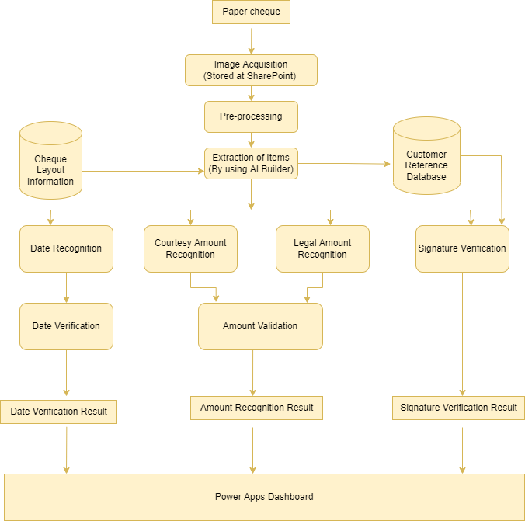
GitHub Repository Link & supporting diagrams, screenshots, if any

Slide 9
Thank You
Team member names
Shubham Sharma
Aman Srivastava
Prafful Jha
Anirudh Singh

